Slide 1
Successes of Selection
Endogenous and Exogenous Effects in Space
Components of Attention
Cross-Modal Links
Object-Based Attention
Notes:
Fortunately, the normal attention system is not as dumb as it may appear. Despite the many failures of selection we are prone to—which may come about because too much information is present at any one location, or because too much information streams rapidly in time, or because our attention is divided—there are many condi­tions under which we can successfully and efficiently select the necessary informa­tion from the input presented to us. (p 118)

Slide 2
Endogenous and Exogenous Effects in Space
When you came into the room, you searched very broadly and rapidly for all green things in the array of colors that surrounded you and then, within this subset of green things, specifically for your friend’s dress.
This sort of attentional process, which has a voluntary aspect, is top down; it originates from within (from your own knowledge, in this case) and hence is called endogenous attention.

Slide 3
Endogenous and Exogenous Effects in Space
But this form of goal-driven or top-down attention, can be overridden: salient and powerful stimuli can capture attention and direct you away from the task at hand.
Attention thus captured is described as exogenous attention, because it is driven in a bottom-up fashion by stimuli generated outside oneself.
Like the sound of the breaking glass, strong color can provide an exogenous cue, and can be very useful: little children on field trips and prisoners in work-release programs wear brightly colored shirts for the same reason.

Slide 4
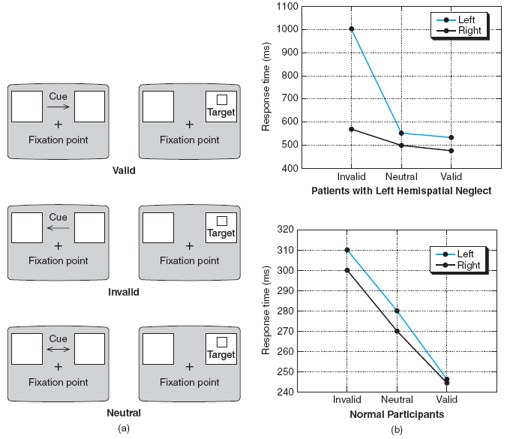
Endogenous Cueing Task
Notes:
(a) In the valid trial, the arrow cue correctly indicates the location of the upcoming target. In the invalid trial, the target appears on the side opposite the cued direction. In the neutral condition, the cue ar­row is double headed and therefore not informative about the likely location of the upcoming target. Usually, in such experiments, there are many more valid than invalid trials so participants take advan­tage of the predictiveness afforded by the cue. (b) Data from normal participants and from patients with hemispatial neglect. Results from normal participants show the advantage—the faster detection time—afforded by the valid cue: target detection in this condition is even better than in the neutral condition. Note that detection time is slowed in the invalid condition, showing the cost when the ar­row cue misleads the participant. There is no real difference in detection performance if the target appears on the left or right side. Patients with left hemispatial neglect were substantially slower when the left target was invalidly cued (note the need for a greater range on the y axis). In this case, the arrow cue points to the right and attention is directed to the right. When the target appears on the patient’s neglected left side, target detection is very slow. (p. 120)

Slide 5
Posner’s Cueing Paradigm
* +

Slide 6
Posner’s Cueing Paradigm
x +

Slide 7
Posner’s Cueing Paradigm
+
x

Slide 8
Posner’s Cueing Paradigm
Shows you where to look
People are very quick to name a target if in cued location
Very slow if they are mis-cued.

Slide 9
Components of Attention
The findings from patients with brain damage led Posner and colleagues to construct a model for attention that involves three separate mental operations: disengaging of attention from the current location; moving attention to a new location; and engaging attention in a new location to facilitate processing in that location.

Slide 10
Components of Attention
Interestingly, Posner and colleagues found other patient groups who appeared to be impaired in either the “move” or “engage” operations posited by their attention model.
Patients with damage to the midbrain and suffering from a disorder called progressive supranuclear palsy seemed to have no difficulty with “disengage” or “engage” operations.
Rather, they were slow in responding to cued targets in the direction in which they had difficulty orienting, suggesting a problem in moving attention to the cued location.

Slide 11
Explaining Attention:
Information-Processing Theories
Early versus Late Attentional Selection
Spotlight Theory
Feature Integration Theory and Guided Search
Notes:
“Paying attention” encompasses dynamic processes that involve the enhancement or selection of particular information and the inhibition of other information. Atten­tion may be thought of as a mechanism that controls processing so that we are not overwhelmed by too much information. Endogenous factors such as one’s knowl­edge and goals and exogenous factors such as the salience of external information can influence the selection. But how does attention work? A number of different information-processing theories have attempted to capture the dynamics of atten­tional effects. Although none of these theories can explain all the attentional phe­nomena we have described so far, the theories offer important insights into the principles that underlie attentional effects. (p. 128)

Slide 12
Early versus Late Attentional Selection
The British psychologist Donald Broadbent (1926–1993) favored the view that selection is made at an early stage of processing.
He proposed a model of the attentional system as containing a limited-capacity channel through which only a certain amount of information could pass.
The many sensory inputs capable of entering later phases of processing, he believed, had to be screened to let only the most important information through.
Notes:
Another suggestion holds that the early-selection view requires only a slight modifica­tion (Treisman, 1969): that in each person’s “dictionary,” or lexical store, some words have lower thresholds of activation than others. Thus, information is still filtered out early, but words that are well known by the listener are more easily de­tected and require less analysis—and hence the information that does get through the filter is sufficient. Thus, one’s own name or a shouted “Fire!” would appear to pass through the bottleneck and capture the listener’s attention. Also, words that are highly probable given the semantic context (such as piccolo following shortly after instruments) may also pass through to our awareness. (p. 130)

Slide 13
Early Versus Late
Early-Selection: before the message is processed for meaning (physical properties only)
Late-Selection: after the messages are processed for meaning (physical & semantic processing)

Slide 14
Attenuation Theory
After the bottleneck, the unattended message is diminished, but not eliminated
  Unattended message will still be processed if it is meaningful/important

Slide 15
Early Late Attenuation
Response
Execution
Response
Execution
Response
Execution
Response
Selection
Response
Selection
Response
Selection
Filter
Semantic
Analysis
Semantic
Analysis
Semantic
Analysis
Filter
Filter
Input
Input
Input

Slide 16
How we study?
Respond to one thing - ignore the rest
Dichotic Listening Tasks:
  Presented 2 messages.
  Shadow one ear and not attend to the other

Slide 17
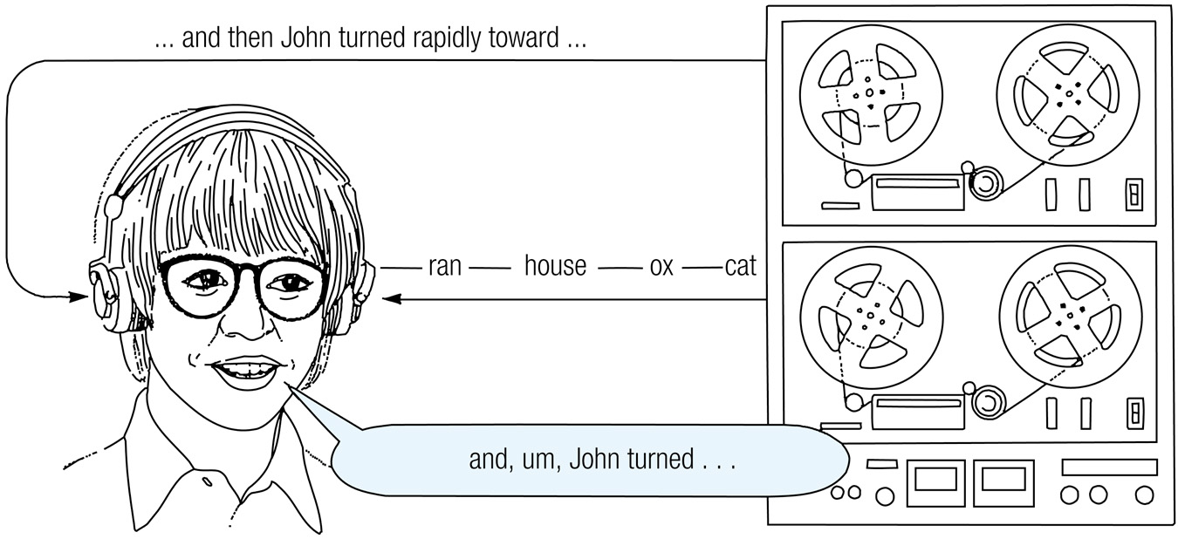
A typical dichotic listening task.

Slide 18
Dichotic Listening
Attended Channel
Today, little Billy took his bicycle across the street to show it to his best friend. They rode their bicycles to the park and played all day. It was nearly dark when…
Unattended Channel
Toad, paper, green, wall, car, bird, paper, lapiz, frijoles, perro, rojo, finger, island, idea, paper, virtue, humor, road, paper, the, goal, interest, home…

Slide 19
What Will People Remember from the Unattended Channel?
What would the early selection theory predict?
What would the late selection theory predict?
What would the attenuation theory predict?
Notes:
Early = shallow, perceptual (no meaning) for unattended channel
Late= full semantic
Attenuation: ignore unattended channel unless meaningful

Slide 20
Early Results
People recall very little from unattended message
  Pitch (gender)
Don’t typically notice:
  Change in language
  Repetition of words
BUT…

Slide 21
Dichotic Listening
Attended Channel
Today, little Billy took his bicycle across the street to show it to his best friend. island, idea, paper, virtue, humor, road, paper, the, goal, interest, home…
Unattended Channel
Toad, paper, green, wall, car, bird, paper, lapiz, frijoles, perro, rojo, finger, They rode their bicycles to the park and played all day. It was nearly dark when…

Slide 22
Later Findings
People will inadvertently switch ears to follow the meaning of the attended channel (Treisman, 1960)
  Is this support for the early selection, late selection, or attenuation theory? Why?
People will hear their own name ~ 35% of the time (cocktail party effect; Wood & Cowan, 1995)

